Slide 1
Utahns sound Utahn when they avoid sounding Utahn
Joseph A. Stanley
Brigham Young University
joeystanley.com
@joey_stan
97th Annual Meeting of the Linguistics Society of America
January 6, 2023
Denver, CO

Slide 2
MOUNTAIN
Today’s sociolinguistic variable: realization of post-tonic, unstressed /tən/
e.g. mountain, button, kitten, satin
Hereafter, a Wellsesque inspirated label: MOUNTAIN
Three main variants:
[tʰɨn]
aspirated alveolar stop + reduced vowel + nasal
AmE citation form, formal, careful
Probably accessible by most speakers.
[ʔn̩]
glottal stop + syllabic nasal
AmE standard, casual, typical.
The most common for probably all speakers.
[ʔɨn]
glottal stop + reduced vowel + nasal
Non-mainstream: found in Utah, New York, and scattered elsewhere (Roberts 2006, Freeman et al. 2012, Eddington & Brown 2021, Davidson et al. 2021)
Notes:
Today I want to talk to about how people in Utah pronounce the unstressed syllable in words like mountain, button, kitten, and satin. For convenience, I’m going to refer to this set of words as MOUNTAIN, in all caps, a convention I borrow from how English dialectologists sometimes refer to vowels.
There are three main variants for MOUNTAIN. [*] The first uses an aspirated alveolar stop, as in moun[tʰɨn], button, kitten, and satin. I’m going to call this the “hyperarticulated” variant. I’d consider it to be the citation form of the word and is probably accessible and used by most people in formal or careful situations.
[*] The second variant uses a glottal stop and a syllabic nasal, as in moun[ʔn], kitten, button, and satin. This is what I’d call the most typical variant in American English. If you’re like me, you probably use this one the most. In fact, probably most American English speakers use this as their primary, default variant.
[*] The third variant is one that you might not have heard as much. It also has a glottal stop but it's what Eddington & Savage (2012) call an “orally-released glottal stop,” as in moun[ʔɨn], button, kitten, and satin. The main difference between this and the mainstream variant is that this one does not have a syllabic nasal but rather retains the underlying vowel. This is heard in Utah, New York, and scattered elsewhere. This variant has reached shibboleth status in Utah, and since I’m talking about Utah English today, I’ll refer to this as the “Utah variant.”

Slide 3
MOUNTAIN in Utah
In Utah, [ʔɨn] occurs ≈15% of the time
Eddington & Savage (2012): 17%, mostly in young females
Eddington & Brown (2019): 12%, mostly in younger people
Stanley & Vanderniet (2018): 12.7%, only among women
But, [tʰɨn] is not analyzed in depth
Stanley & Vanderniet (2018) point out that it’s used more than [ʔɨn] is.
Other work on MOUNTAIN in Utah has not acknowledged this third variant.
Notes:
As far as the Utah variant is concerned, it seems to occur roughly 15% of the time, based on the few studies that have analyzed it. It seems to be more common among younger women and when it comes to perception, it’s associated with less education and being more rustic.
But today, my focus is not on moun[ʔɨn] but rather on moun[tʰɨn]. This variant is not analyzed very much, though in previous work with Kyle Vanderniet, I show that it appears to be more common than the Utah variant. So despite the previous work on the MOUNTAIN variable, none have acknowledged moun[tʰɨn] as a third variant in Utah. Today’s talk shows why that is an unfortunate oversight.

Slide 4
Today, I want to show you that…
Hyperarticulated [tʰɨn] is the most common variant in Utah.
This pattern is uniquely Utahn.
This arose because of stigma “erroneously” associated with the glottal stop.
Notes:
So, with that in mind, this brings me to the story of today’s talk. Today, I want to show you that the hyperarticulated variant is in fact the most common variant in Utah. I then want to show you that this is something that appears to be uniquely Utahn, as far as I can tell. Finally, I want to provide evidence to suggest that this pattern of using the hyperarticulated variant the most, arose because of the stigma erroneously assigned the glottal stop.

Slide 5
Data and Methods

Slide 6
Acoustic Data
200-item wordlist
Included 17 MOUNTAIN words: Britain, button, certain, Clinton, cotton, fountain, gluten, kitten, Latin, mitten, mountain, potent, satin, Scranton, sentence, threaten, titan
Remote audio collection
Qualtrics survey with a Phonic plug-in allowed for audio collection
Participants recorded on their own devices
Audio quality was variable but overall pretty good (cf Stanford 2019)
Distribution
Posted it to 38 Utah-related subreddits (r/Utah, r/SouthernUtah, r/BYU, r/SaltLakeCity, etc)
116 born-and-raised Utahns completed the survey: 1,808 tokens
Notes:
The evidence I have for this story comes from wordlists. Specifically, I put together a 200-item wordlist containing lots of words that are known to be variable in Utah. Today, I’ll just be focusing on the 17 MOUNTAIN words, which I’ve listed here.
I incorporated this wordlist into a Qualtrics survey and asked participants to record themselves reading it out loud. This was possible by using Phonic, which is a third-party plug-in that allows participants to record audio right there within a Qualtrics survey. Like what Jim Stanford and colleagues found in their self-recorded data in New England, the audio quality was variable but overall pretty good.
I then used Reddit to find participants. I posted the survey to as many Utah-related subreddits that I could find, including ones specific to regions, universities, and cities. In the end, 116 born-and-raised Utahns completed the survey and produced 1,808 usable tokens.

Slide 7

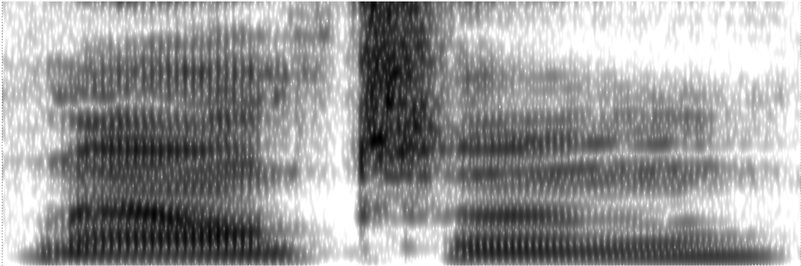
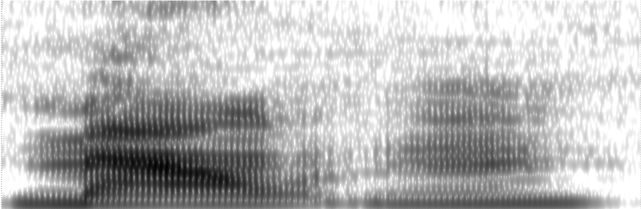
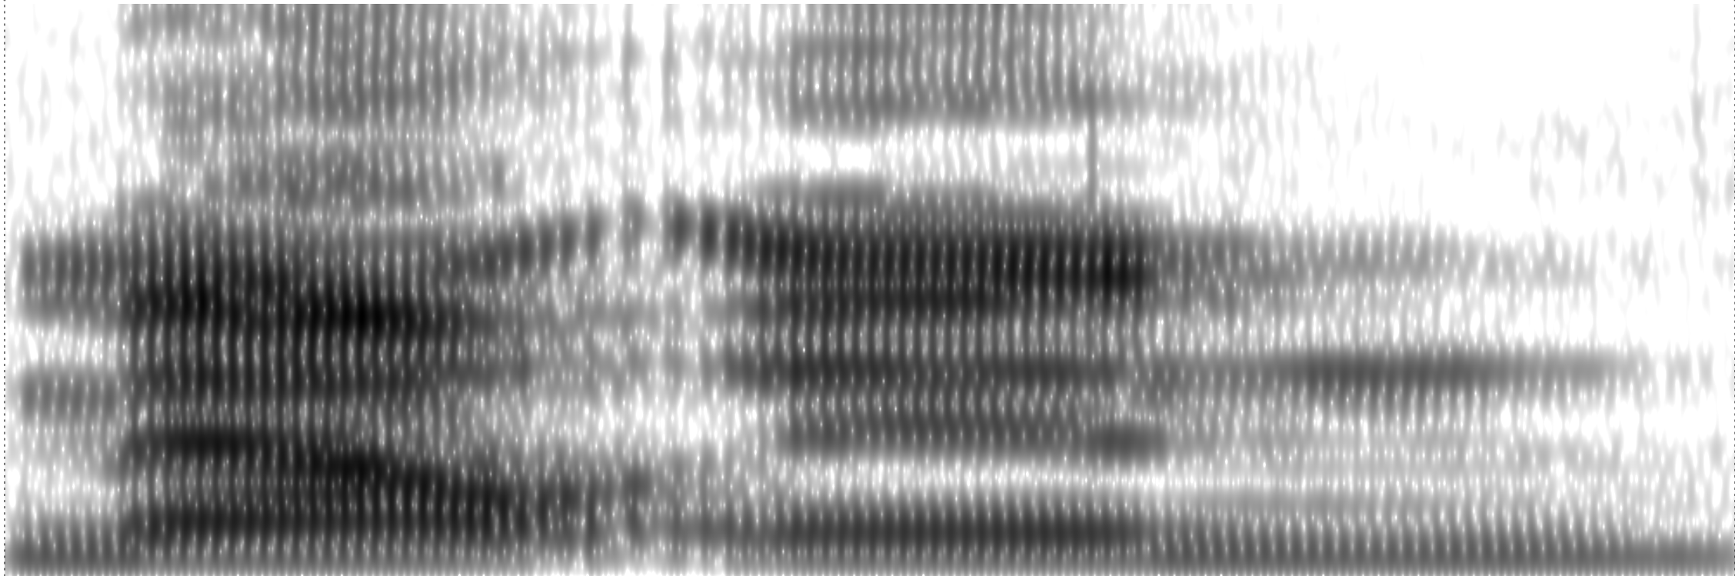
Processing
I just listened to each one, using spectrograms when necessary.
(I’d love your ideas on what acoustic measures I could take to quantify this better!)
Notes:
To process this acoustic data, I simply listened to each token several times and coded it into one of the three variants. Alveolar stops were easy to hear. If there wasn’t one, I listened for the presence of a vowel after the glottal stop. Sometimes, I had to use the spectrogram to look for formant structure. Here you can see each of the three variants, and here’s what they sound like.

Slide 8
Attitudinal Data
After the wordlist, they were asked to respond to several open-ended questions (cf. Holland & Brandenburg 2017)
Most important for this study: “Do you think Utah has its own accent?”
Total: 18,530 words, 2h 4m of audio
Median response: 143 words, 74 seconds
Qualitative coding
Does Utah have an accent?
Was rurality mentioned?
Specific places that were mentioned.
Linguistic features mentioned, alluded to, imitated, etc.
What specifically about MOUNTAIN was mentioned?
Notes:
In addition to this wordlist data, I also collected some attitudinal data. This was done by asking participants to record themselves responding out loud to the prompt: ”Do you think Utah has its own accent?” The typical response was a over a minute long. I went through all the responses and coded for a few things including whether they think Utah does have an accent and whether MOUNTAIN was specifically mentioned. All of this was somewhat fuzzy data collection because the responses varied considerably in their length and detail, but there were enough of them to provide a good picture of what’s going on.

Slide 9
Results

Slide 10
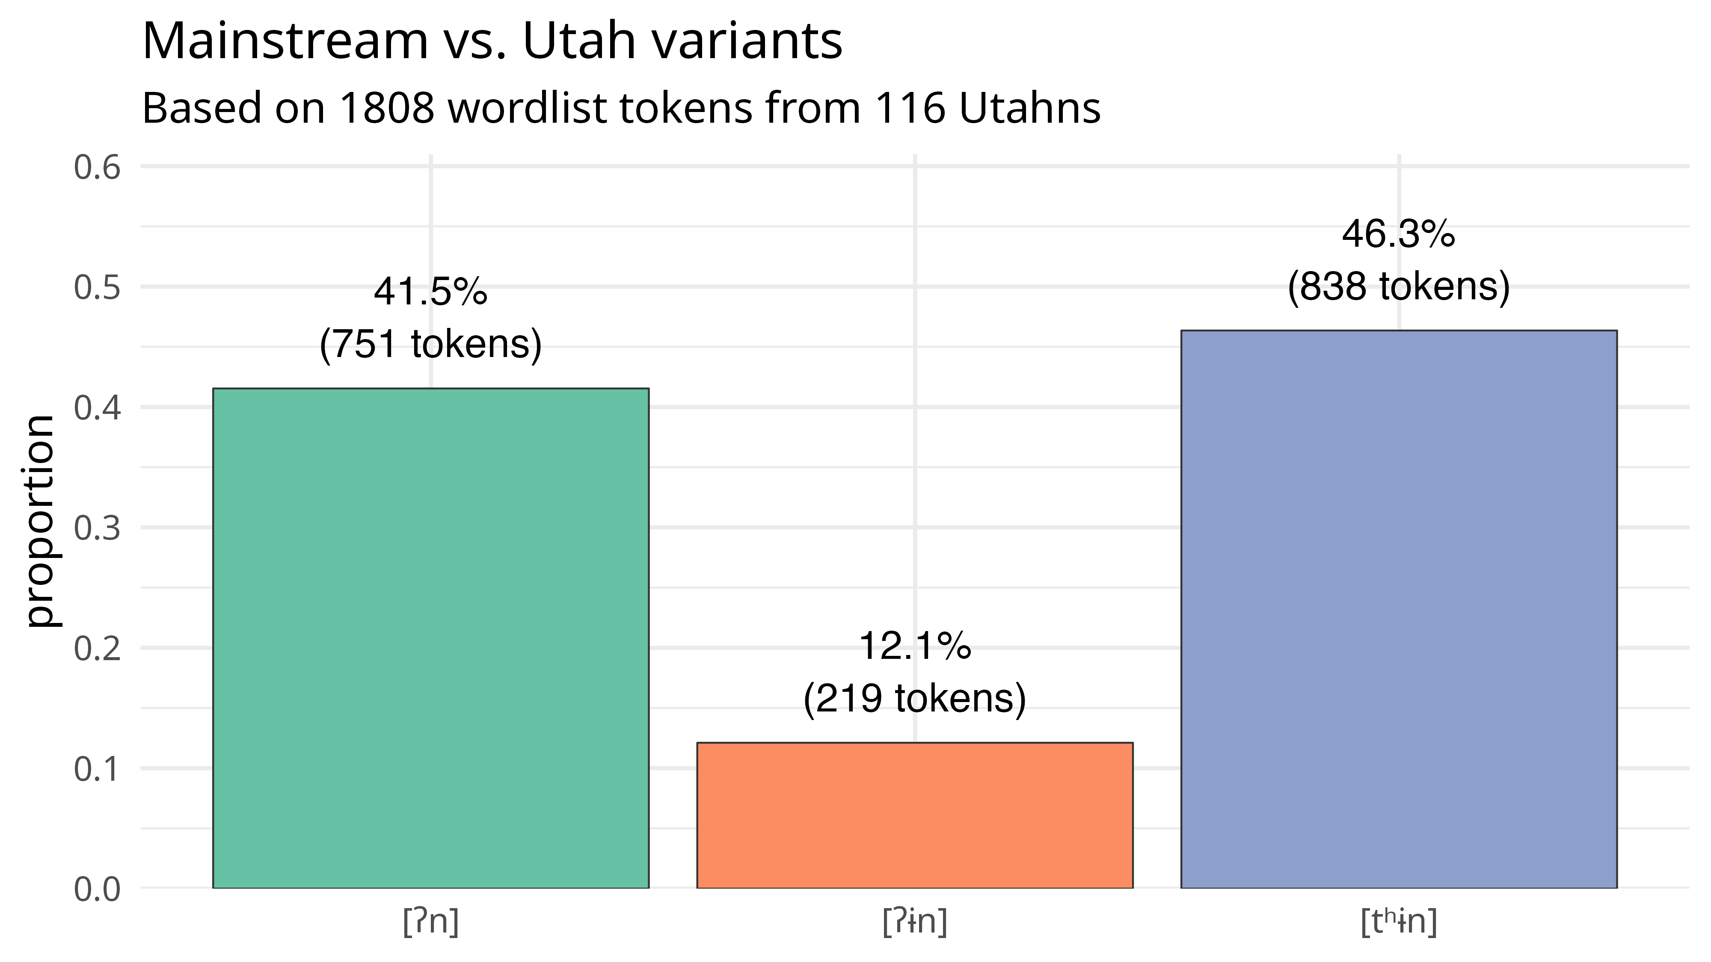
Notes:
Here’s a first look at the distribution of the mainstream variant and the Utah variant. As you can see, there are more mainstream tokens than Utah tokens. As far as demographic factors, linear modeling suggests that the people who use the Utah variant the most were women, people born after about 1993, people from central Utah and smaller towns in northern Utah, practicing Mormons, and people that want to live in small towns (as opposed to urban, suburban, or rural areas).
But the main purpose of this talk is not to simply describe who says what variant because my findings are pretty similar to previous work. What I want to highlight is the really interesting meta-linguistic commentary I got from these participants.

Slide 11
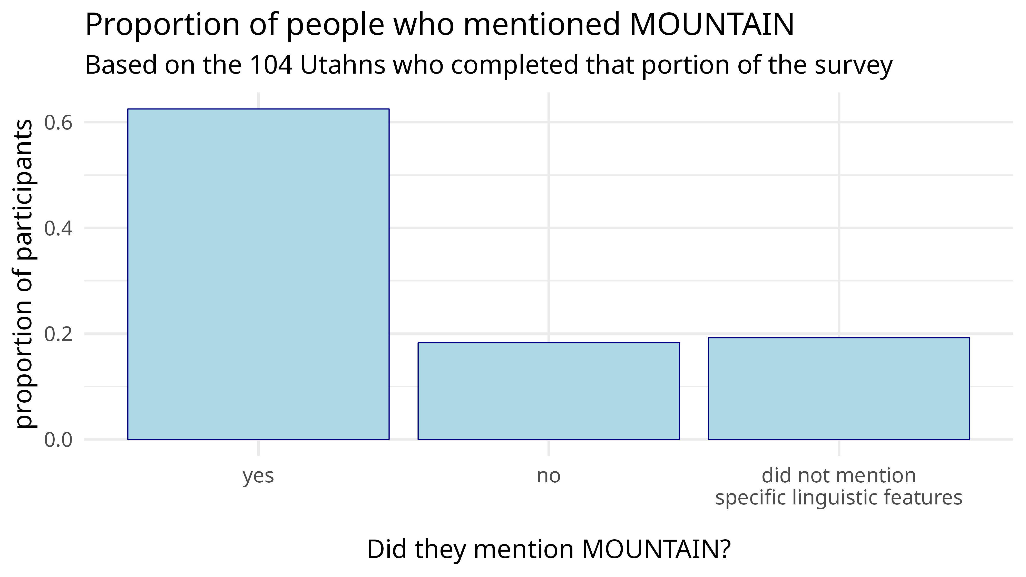
This checks out (cf. Stanley 2022)
Notes:
To start off, 62.5% of the Utahns mentioned MOUNTAIN in some way in their comments, and it was almost always the first feature they listed, if they even mentioned anything else. This supports Stanley (2022) where I find that it’s the most frequently mentioned phonological feature in draw-a-map tasks among Utahns. I don’t exactly have comparable numbers from other regions, but to me that 62.5% figure seems like a lot. That means that if you asked a random Utahn about Utah English, there’s a better-than-chance odds that they’ll mention this one feature. I saw this for myself a few years ago when I flew out to Utah to do fieldwork. I’d introduce myself and ask people about Utah English and they said, “Oh, so you want me to say mountain, right?” Or one time I had someone read a wordlist that was 200 words long, chock full of words known to be variable in Utah, and when they were done, the person said, “Did you make me read this whole thing just to get me to say mountain?” So it’s something that people are hyperaware of.

Slide 12
Notes:
So how are Utahns responding to this awareness? Well if you’re quick at doing math while listening to me, you’ll notice that plot that I showed you before wasn’t the whole story. In fact, it was only half the story.

Slide 13
Notes:
When we add the third, hyperarticulated variant to the picture, we can see that it’s used more than the other two. About 46% of the tokens were this hyperarticulated form. In fact 22 people used it 100% of the time, in all 17 words. Remember how I said 62% of people talk about MOUNTAIN? That number goes up to 80% among those who use it categorically.
Now, for anyone who has read Labov’s work, you’ll know that people use more careful variants in more careful styles like wordlists. Perhaps this is just a visual representation of that. There is certainly some of that going on, but how can we disentangle style effects from something more interesting?

Slide 14
Control Group
Also posted it to Idaho-, Montana-, and Wyoming-based subreddits.
Same questions and a similar wordlist, though not identical.
162 people across the three states
Also posted it to r/SampleSize
Same wordlist; abbreviated questionnaire
31 people
Notes:
To answer this, I collected data from non-Utahns to make sure that the patterns I found are indeed unique to Utah. I posted the survey to Idaho, Montana, and Wyoming–based subreddits to get a picture of non-Utah Mountain West production and attitudes. I got 162 people across those three states. I also posted it to a general survey subreddit to get people from other parts of the country and got another 31 people.

Slide 15
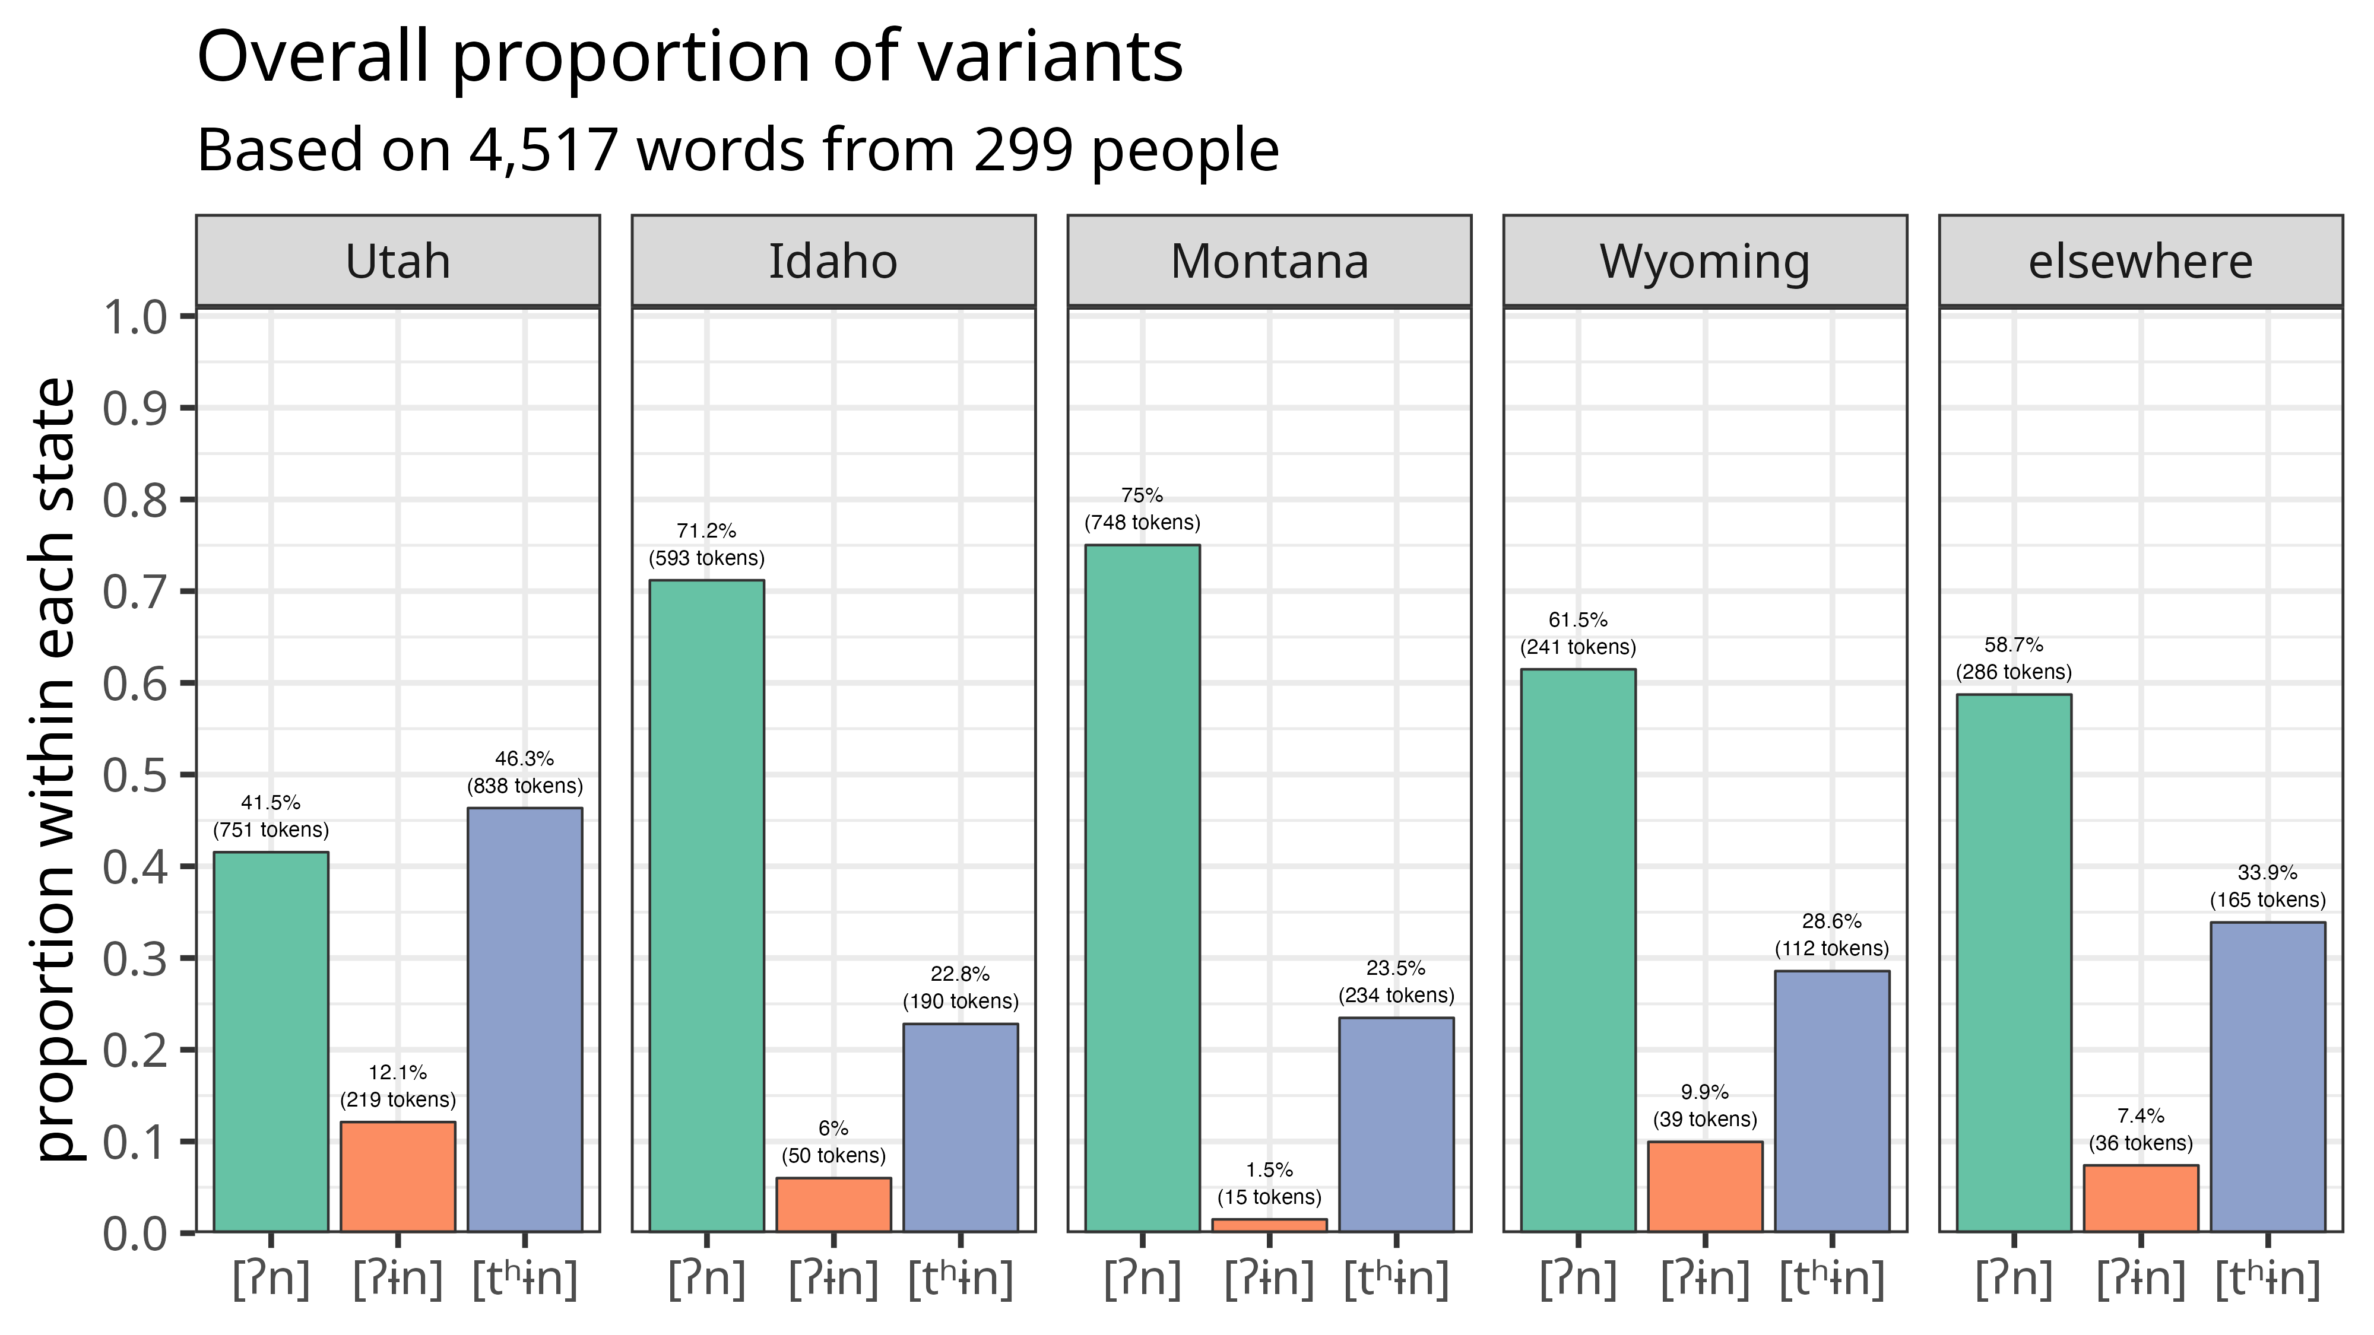
?
style
effects
Notes:
So we can augment our previous plot of the Utah data by adding information from the other three states in the West as well as the other control group. Here we see a rather stark difference between the Utahns on the far left and everyone else. When we look at the other plots, we see first off that the Utah variant, represented here in orange, is attested but less common. But looking at the height of the hyperarticulated variant in blue, we see that it’s there in the other states’ data, but definitely not as much as Utah. On average, the other regions used it 25.9% of the time. We might therefore say that a 25% of the total number of tokens, or 56% of the hyperarticulated ones in Utah, are attributable to style effects. So then what’s the other 44% of the hyperarticulated tokens? That’s the part that makes Utah unique.

Slide 16
The Story of MOUNTAIN
Notes:
Based on my observations after living in Utah for a few years now and looking through people’s comments, here’s the story of what I think happened.

Slide 17
The Story
Utah [ʔɨn] develops.
Utah [ʔɨn] is stigmatized
Hyperarticulated [tʰɨn] is correct and glottal stops are bad
Utah has no accent
Mainstream [ʔn̩] is Utahn
Mainstream [ʔn̩] is stigmatized
Notes:
The Utah variant, at some point, develops in Utah. I don’t have precise data on this, but I have listened to a lot of recordings from folks born in the early 1900s and they don’t say moun[ʔɨn] at all. So I’d say starting with maybe the Silent Generation or the Baby Boomer generation is when moun[ʔɨn] develops. This supports Bowie (2021) who "almost never" heard it among people born around the turn of the century.
At some point that variant then becomes stigmatized. Again, I don’t have precise data on this but based on what I understand about Utah history and Mormon history, I’d say it was around the 1960s. Prior to then, most Utahns were Mormon and most Mormons were from Utah and the whole state was pretty insular. It was around then though that Utah started to see more outsiders coming in. Perhaps they were the ones that first noticed and made fun of younger Utahns saying moun[ʔɨn].
It’s at this point that my data can start to support what’s going on. And as evidence for the rest of these stages, I’m going to let some of my participants explain them to you.

Slide 18
The Story
I’m pretty sure that before I moved here I said moun[ʔɨn] and Lay[ʔɨn]. But I have been made aware of them. And so I have said them correctly now.
“Jane”, female, b. 1963, White, Logan, practicing Mormon, rural-oriented
Utah [ʔɨn] develops.
Utah [ʔɨn] is stigmatized
Hyperarticulated [tʰɨn] is correct and glottal stops are bad
Utah has no accent
Mainstream [ʔn̩] is Utahn
Mainstream [ʔn̩] is stigmatized
So I have like a memory being being at Disneyland
wanting to ride Space Moun[ʔɨn]. And my mom said she didn’t know what that ride was. And I did not understand that she was trying to get me to say the t in moun[tʰɨn]. So it was like a big fight. Slight meltdown. She laughed a little bit. Apologized. And said, “I was just trying to get you to say moun[tʰɨn] instead of moun[ʔn̩].”
“Skylar”, female, b. 1998, White, South Weber, practicing Mormon, suburban-oriented
Notes:
So, by around the 1980s, the Utah variant, moun[ʔɨn], was stigmatized. Jane, one of my oldest participants, noticed this when she moved from Logan, a smaller town in northern Utah, to Salt Lake City, the primary metropolitan area in the state.
Before saying this, Jane used the hyperarticulated one in all but two of the words in her wordlist. Here’s Skylar.
Skylar was one of several Gen Zers who said that they use the hyperarticulated variant because their parents corrected them. These parents were likely Gen Xers. So, perhaps with comments like these, we can start to date when this stigma arose, or at least pinpoint the generation that first felt the stigma. It appears to be Gen Xers or people born between about 1965 and 1985.

Slide 19
The Story
Do I think I have an accent? Yeah, I actually do. Like when I say words like moun[ʔɨn]. *chuckles* Um, I know a lot of other people say moun[tʰɨn]. I think we’re just a little bit lazy on our pronunciation.
“Sylvia”, female, b. 1984, White, Blanding, ”other” religious affiliation, suburban-oriented
Utah [ʔɨn] develops.
Utah [ʔɨn] is stigmatized
Hyperarticulated [tʰɨn] is correct and glottal stops are bad
Utah has no accent
Mainstream [ʔn̩] is Utahn
Mainstream [ʔn̩] is stigmatized
Um, Utah County is pretty heavy on the glotteral [sic] stop. That ugly t. *chuckles* Um, uh, or lack thereof, I suppose.
“Deborah”, female, b. 1989, White, Highland, ex-Mormon, suburban-oriented
However, I try very hard to not sound, uh like I’m from the country or like I’m a hick. I often run into that in Utah, people don’t pronounce their t’s. My mother was very specific about us speaking, um, formally, I suppose.
“Anastasia”, female, b. 1987, White, Logan, ex-Mormon, urban-oriented
Notes:
So, if the local realization of moun[ʔɨn] is stigmatized, what are people switching to? Well, you heard in Skylar's recording that she switched to the hypercorrect form, moun[tʰɨn]. Why that one and not the mainstream moun[ʔn]? Well, it’s clear from others’ comments that it is the glottal stop that is stigmatized. Here’s Sylvia saying that it’s lazy when people use the Utah variant.
Deborah here calls the glottal stop ugly.
It turns out Deborah used the hyperarticulated variant 100% of the time. And here’s Anastasia, who also used it 100% of the time.
So, people actively avoid the glottal stop, and it appears to index a lot of negative things. Logic would suggest then that, for these people, the hyperarticulated form is the ”correct” one because it doesn’t have a glottal stop.

Slide 20
The Story
My like most natural speaking tone, the way that I’m talking now, I wouldn’t say is a noticeably different speech pattern from, yeah, the kind of accent that’s used on TV or on the news.
“Kelsie”, female, b. 1994, White, Payson, non-practicing Mormon, small town–oriented
Utah [ʔɨn] develops.
Utah [ʔɨn] is stigmatized
Hyperarticulated [tʰɨn] is correct and glottal stops are bad
Utah has no accent
Mainstream [ʔn̩] is Utahn
Mainstream [ʔn̩] is stigmatized
Yeah, I feel like I have an accent. Uh, the Hollywood accent. Super lucky that pretty much everywhere we go, our English accent is super understandable.
“Deborah”, female, b. 1989, White, Highland, ex-Mormon, suburban-oriented
Notes:
Mixed in with this story is an ideology that has become rather pervasive in Utah, and that is that Utahns don’t have accents. Well, at least younger Utahns who live in the urban area along the Wasatch Front. Here’s Kelsie who feels like her accent is the same as what you’d hear on the news.
And here’s Deborah again who feels like her accent is the Hollywood accent.
I’ve heard similar comments from my students. They say that their grandparents have a Utah accent, but they don’t. When I ask them what accent they have if not a Utah accent, they say that they simply don’t have an accent. So, when you get a generation of younger, urban Utahns who have been raised thinking that moun[ʔɨn] is bad because of the glottal stop, that moun[tʰɨn] is good and correct, and that Utahns don’t have an accent, it sets the stage for the last two parts of the story.

Slide 21
The Story
Most people with a strong Utah accent uh leave the t off a lot of words. I say moun[ʔn̩] instead of moun[tʰɨn], uh so I do think I have that accent.
“Louis”, male, b. 1997, White, Bountiful, practicing Mormon, small town–oriented
Utah [ʔɨn] develops.
Utah [ʔɨn] is stigmatized
Hyperarticulated [tʰɨn] is correct and glottal stops are bad
Utah has no accent
Mainstream [ʔn̩] is Utahn
Mainstream [ʔn̩] is stigmatized
What I’ve noticed is that there’s a swallowing of t’s a lot more in younger people these days. That- I don’t recall that as much from when I was a kid. Y’know people will say moun[ʔn̩], Clin[ʔn̩], that kinda thing, where the t is swallowed.
“Douglas”, male, b. 1965, White, West Jordan,
non- Mormon, urban-oriented
Notes:
So far though, we haven’t talked about the mainstream variant. Because a lot of Utahns who grew up being told that Utahns “swallow their t’s”, we now have people who think that the mainstream variant, moun[ʔn] is unique to Utah. Here’s Louis who pretty clearly describes this as part of a strong Utah accent.
He was right because he used the mainstream variant almost categorically. And here’s Douglas, who is feels like people didn’t say glottal stops as much in the 1970s.
Turns out he used glottal stops most of the time, except in mountain and Clinton.
So, there’s this idea then that glottal stops and any variant that uses a glottal stop is something that’s unique to Utah. These are just two quotes, but I could have put in dozens more if I had the time. Ask me in the Q&A for more if you’d like.

Slide 22
The Story
There have also been some conscious things over my life. Like, I’ve cons- consciously tried to say the word moun[tʰɨn] instead of moun[ʔn̩]. But I feel like my natural tendency is to- is to say moun[ʔn̩]. But I prefer saying moun[tʰɨn] because I think it sounds better. And so there are little things over the t- my time um, being alive that I’ve just adjusted um to kinda be more neutral and more pleasing.
“Mayra”, female, b. 1990, White, Orem, ex-Mormon, suburban-oriented
Utah [ʔɨn] develops.
Utah [ʔɨn] is stigmatized
Hyperarticulated [tʰɨn] is correct and glottal stops are bad
Utah has no accent
Mainstream [ʔn̩] is Utahn
Mainstream [ʔn̩] is stigmatized
There’s certain words that I’ve tried not to say. Like I used to have more of a Utah accent with moun[tʰ]- moun[ʔn̩]. And then people kinda made fun of it. So I started trying more to pronounce the t and I specifically say moun[tʰɨn] with the t.
“Charity”, female, b. 1986, White, unspecified Utah, ex-Mormon, suburban-oriented
Notes:
So, that logically leads to the final part of this story. If Utahns “swallow their t’s”, moun[tʰɨn] is correct, and glottal stops are bad, then according to Utah logic, even the nationwide standard, moun[ʔn] is bad. Here are Mayra and Charity, who both flat out say that they suppress their natural way of speaking in favor of the hyperarticulated form.
Turns out Mayra uses a mix of variants, but Charity is a categorical user of the hyperarticulated variant.
So the variant that probably everyone in this room uses the most is, in Utah, seen as a Utah thing and is stigmatized. Now, as a reminder, the only difference between mainstream moun[ʔn] and Utah moun[ʔɨn] is the vowel in the Utah variant. But, it’s clear from these comments that what’s stigmatized about it is not the vowel, but the glottal stop. So, they’ve misplaced the stigma.

Slide 23
?
style
effects
Notes:
So, going back to this plot that I showed before, what has happened is that the stigma that’s associated with the Utah variant has spread to the mainstream variant due to the glottal stop that they share. So, to avoid the stigma associated with the glottal stop, Utahns use the hyperarticulated variant. The extra-tall blue bar on the far left panel of this plot shows that this only really happens in Utah. So, in a delicious bit of irony, Utahns sound Utahn when they avoid sounding Utahn.

Slide 24
Discussion

Slide 25
Shibboleth in Utah
A rare(?) case of the mainstream variant being so overtly stigmatized.
Unlike other areas, where they don’t hear the non-standardness of their speech (Niedzelski 1999), they fail to hear the “non-standard” variants in others’ speech.
They’re unaware of what the mainstream variant even is.
“Your brain gets in the way of your ear.” (Preston 2018)
They hypercorrect towards a fictitious standard.
Notes:
What is so interesting about this is that the national standard, moun[ʔn], is locally stigmatized. And not stigmatized in the sense of the local variant has covert prestige or anything; the mainstream one has all the negative associations. As far as I know, this doesn’t happen that often.
It reminds me of Niedzelski (1999) who found that Michiganders failed to hear the stigmatized variants in their own speech. They had such high linguistic security that they were sure that they speak standard English and failed to hear the nonstandard speech literally under their noses. As Preston (2018) describes, ”their brain gets in the way of their ear.”
In Utah though, what’s happening is that they’re failing to hear that, what they perceive to be stigmatized, is in fact the mainstream variant. It’s on movies, TV, podcasts, newscasters, you name it. But Utahns are so convinced that the glottal stop is a Utah thing and they’re so sure they don’t have accents, that they fail to hear it in others’ speech. I’ve even asked people this directly: how do you think most non-Utahns say mountain, and most people respond with moun[tʰɨn]. So, they’re hypercorrecting towards a fictitious standard that only they believe in. Even though MOUNTAIN is the most discussed feature of Utah English, it is also the most misunderstood.

Slide 26
Hopefully, I’ve convinced you that…
Hyperarticulated [tʰɨn] is the most common variant in Utah.
This pattern is uniquely Utahn.
This arose because of stigma “erroneously” associated with the glottal stop.
Notes:
So, hopefully today I’ve convinced you that the hyperarticulated moun[tʰɨn] is the most common variant in Utah, that it’s only in Utah that you get that pattern, and that the pattern arose because people erroneously assigned the stigma to the glottal stop and are hypercorrecting towards moun[tʰɨn] as a way to avoid that stigma. There is a lot of juicy sociolinguistic stuff going on in Utah and I’m glad I was able to share some of that with you today. Thanks.

Slide 27
References
Bowie, David. 2022. How old are the moun[ʔə]ns in Utah? Utahn “t-dropping” over time and across the lifespan. Presented at the Methods in Dialectology, Mainz, Germany.
Davidson, Lisa, Shmico Orosco & Sheng-Fu Wang. 2021. The link between syllabic nasals and glottal stops in American English. Laboratory Phonology: Journal of the Association for Laboratory Phonology 12(1). 4. https://doi.org/10.5334/labphon.224.
Eddington, David Ellingson & Earl Kjar Brown. 2021. A production and perception study of /t/ glottalization and oral releases following glottals in the US. American Speech 96(1). 1–41. https://doi.org/10.1215/00031283-8620501.
Eddington, David & Matthew Savage. 2012. Where are the moun[ʔə]ns in Utah? American Speech 87(3). 336–349. https://doi.org/10.1215/00031283-1958345.
Freeman, Valerie, John Matthew Riebold & Robert Skyes. 2012. To [t] or not to [t]: Those are the strategies. Presented at the University of Washington Department of Linguistics Colloquium, Seattle.
Holland, Cory & Tara Brandenburg. 2017. Beyond the Front Range: The Coloradan Vowel Space. In Valerie Fridland, Alicia Beckford Wassink, Tyler Kendall & Betsy E. Evans (eds.), Speech in the Western States, Volume 2: The Mountain West (Publication of the American Dialect Society 102), 9–30. Durham, NC: Duke University Press. DOI: 10.1215/00031283-4295277.
Niedzielski, Nancy. 1999. The Effect of Social Information on the Perception of Sociolinguistic Variables. Journal of Language and Social Psychology 18(1). 62–85. https://doi.org/10.1177/0261927X99018001005.
Preston, Dennis R. 2018. Language Regard: What, Why, How, Whither? In Betsy E. Evans, Erica J. Benson & James Stanford (eds.), Language Regard, 3–28. 1st edn. Cambridge University Press. https://doi.org/10.1017/9781316678381.002.
Roberts, Julie. 2006. As Old Becomes New: Glottalization in Vermont. American Speech 81(3). 227–249. https://doi.org/10.1215/00031283-2006-016.
Stanford, James N. 2019. New England English: large-scale acoustic sociophonetics and dialectology. New York, NY: Oxford University Press.
Stanley, Joseph A. 2022. Perceptual Dialectology of Utah. Schwa: Language and Linguistics Winter 2022(26). 1–10.
Stanley, Joseph A. & Kyle Vanderniet. 2018. Consonantal Variation in Utah English. In Proceedings of the 4th Annual Linguistics Conference at UGA, 50–65. Athens, Georgia: The Linguistic Society at UGA. https://hdl.handle.net/10724/37876.

Slide 28
Utahns sound Utahn when they avoid sounding Utahn
Joseph A. Stanley
Brigham Young University
joeystanley.com
@joey_stan
These slides area available at
joeystanley.com/lsa2023

Slide 29
Bonus Quotes

Slide 30
You don’t believe in ‘T’. Not tea, but the letter ‘t’ — because as far as you can tell from your neighbors, you live in ‘Lay’on’ by the ‘moun’in.’
Dan Kunz. MatadorNetwork.com. March 13, 2015.
Mountain= Mown’un: How could this NOT be the number one Utah-ism? The dropped T is infamous. But it doesn’t just drop, it almost makes a staccato sound where the T should be when pronounced.
20 words you need to know how to pronounce in Utah. Daily Herald. December 20, 2016.
Another thing I notice about Utah accents is that we drop or swallow the "nt" combination - as in mountain - which ends up sounding like "mou in".
UtahRoots. Comment to a post on city-data.com. January 13, 2011.
I have noticed that, in some cases, people from Utah omit the 't' from words such as 'Layton' and 'mountain.’
bill999. Question asked on English Language & Usage Stack Exchange. July 22, 2014
exmo88: My ex-mo family left Utah in 1964. Over the years, I couldn't help but notice the accent people from Utah have. Is it predominately Mormon or is it all of Utah? One thing's for sure, it's very distinct.
Readbooks6: Moun-en instead of mountain. The "t's" disappear.
bananajr6000: Yup, that's a classic one
Reddit exchange in r/exmormon. 2015.
"Mou'uns" is a dead giveaway you're talking to a Utahn.
Comment by BizarroBednar on a Reddit post in r/exmormon by exmo88. 2015.
Notes:
To briefly step aside from the current dataset and look at other data, I’ve been scouring the internet for comments on Utah English for years now, and it’s clear too that MOUNTAIN is the thing that people mention the most. Here we see just a sample of comments that all mention glottalization in mountain. The other word people mention is Layton, which is a northern suburb of Salt Lake City.

Slide 31
The most egregious of course that, I’m sure that you and other people who talk about this are aware is, the Utah accent when people drop the t’s that are in the middle of words like moun[ʔɨn] and cur[ʔɨn].
Unfortunately, even though I’m from Utah I was raised by a father that really, really hated when I said stuff like that. And so I actually do say moun[tʰɨn] and cur[tʰɨn].
“Cooper”, male, b. 2002, White, Orem, ex-Mormon, unknown rural/urban orientation

Slide 32
Even from like a young age I got kind of scolded by my parents because I’d say moun[ʔɨn] instead of moun[tʰɨn].
“Makenna”, female, b. 2002, Asian American, Salt Lake City, non-Mormon, suburban-oriented

Slide 33
Um, but most of the time I feel like especially my generation or my age and younger have very like normalized, that takes out all of more of the variation in language, um, in pronunciation.
“Cecilia”, female, b. 1995, White, Orem, nonpracticing Mormon, urban-oriented

Slide 34
Going to high school with a bunch of kids from Hill Air Force Base, so they’d been all over the United States, and um, they talked, like, just kinda y’know like, y’know how people talk on TV, I mean, I would say that they talk more of a American standard I guess just from living all over the United States and sometimes overseas.
But the longer they lived here I notice that they would start dropping t’s.
“Skylar”, female, b. 1998, White, South Weber, practicing Mormon, suburban-oriented

Slide 35
People say like moun[tʰɨn] is pronounced differently in Utah. Like some people say moun[ʔn̩] and like drinking foun[ʔn̩] and stuff like that.
“Antonio”, male, b. 2000, Latino, Provo, ex-Mormon, urban-oriented

Slide 36
I feel like the accent is typically demonstrated in words like moun[tʰɨn]. Uh, I’m saying it there with, with correct diction. Uh, but I feel like often the Utah accent skips over the t in moun[tʰɨn] and in other words as well, uh, like bu[ʔn̩], bu[tʰɨn], bu[ʔn̩].
“Braxton”, male, b. 1998, White, North Logan,
practicing Mormon, suburban-oriented

Slide 37
I do think I have an accent. And I kinda embrace it. I tried not to have it for a long time. But I definitely say moun[ʔn̩] and I say bu[ʔn̩]. And I have no shame about it.
“Lynn”, female, b. 1969, White, Provo, nonpracticing Mormon, suburban-oriented

Slide 38
But, definitely Utahns are known for dropping the t’s in Lay[ʔn̩], moun[ʔn̩], stuff like that and I, I know I do that. Um I catch myself doing that. And I do correct myself depen-ding on who I’m with. For example, I work with ESL kids at a middle school during the school year and I am very careful when I’m reading with them to pronounce words correctly as they are writ[ʔn̩], rather than defaulting to my normal spoken accent. Um, so it’s something that I’m aware of and I know that I can correct it.
“Charlene”, female, b. 1982, White, Salt Lake City, practicing Mormon, suburban-oriented

